Slide 1
Wine data analysis author: Akanchha bagla Revision number: 1.0 last date of revision: May 30, 2022
Architecture

Slide 2
TABLE OF CONTENTS
Document Version Control
Introduction
Architecture
Tableau Server Architecture
Tableau Architecture Description
Tableau Server Components
Advantages of Tableau Server
Deployment
Deployment

Slide 3
DOCUMENT VERSION CONTROL
Date Issued | Version | Description | Author
May 30, 2022 | 1.0 | Introduction, Architecture | Akanchha Bagla
REVIEW
Date Issued | Version | Reviewer | Comments
APPROVAL
Date Issued | Version | Approved By | Comments

Slide 4
1. Introduction
1.1 What is Architecture Design Document?
Any software needs the architectural design to represent the design of the software. IEEE defines architectural design as “the process of defining a collection of hardware and software components and their interfaces to establish the framework for the development of a computer system.” The software that is built for computer-based systems can exhibit one of these many architectures. Each style will describe a system category that consists of:
•A set of components (eg: a database, computational modules) that will perform a function required by the system.
•The set of connectors will help in coordination, communication, and cooperation between the components.
•Conditions that how components can be integrated to form the system.
•Semantic models help the designer to understand the overall properties of the system.
1.2 Scope:
Architecture Design Document (ADD) is an architectural design process that follows a step-by-step refinement process. The process can be used for designing data structures, required software architecture, source code and ultimately, performance algorithms. Overall, the design principles may be defined during requirement analysis and then refined during architectural design work.

Slide 5
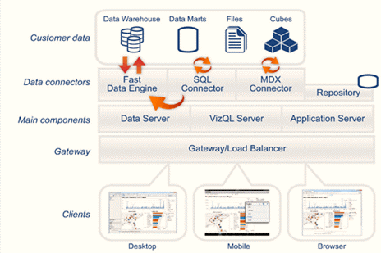
2. Architecture

Slide 6
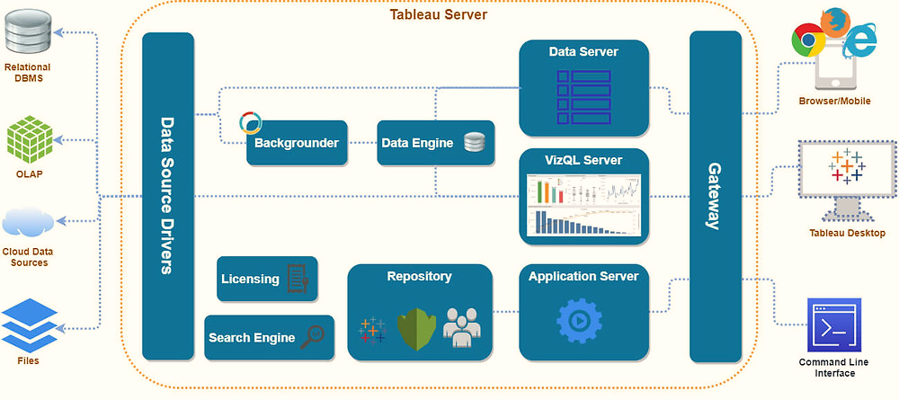
2. Architecture
Tableau Server Architecture:
Tableau has a highly scalable, n-tier client-server architecture that serves mobile clients, web clients and desktop-installed software. Tableau Server architecture supports fast and flexible deployments. The following diagram shows Tableau Server’s architecture:
Tableau Server is internally managed by the multiple server processes.

Slide 7
2. Architecture
2.1 Data Layer:
One of the basic characteristics of Tableau is to support your choice of data architecture. Tableau does not need your data to be stocked in any single system, proprietary or otherwise. Nearly all companies have a heterogeneous data environment, data warehouses live alongside databases and data cubes and flat files, such as Excel, are still very much in use. You do not have to get the entire data in memory until you choose to do so. If your existing data platforms are fast and scalable, then Tableau permits you to directly control your investment by utilizing the power of the database to respond to problems. If this is not the case, then Tableau provides simple options to improve your data to be fast and responsive with your fast in-memory data engine.
2.2 Data Connectors:
It consists of a number of optimized data connectors for databases. There are also common open database connectivity (ODBC) connectors designed for any system without a native connector. Tableau offers two modes in support of interacting with data—live connection or in-memory. Clients can switch between alive and in-memory connections as they desire.
2.3 Live Connection:
The data connectors of Tableau control your available data infrastructure by transferring dynamic SQL or MDX statements directly to the source database, except for importing all data. If you have provided a quick and analytics-optimized database, such as Vertica, then you will get the advantages of that investment by connecting live to your data. This leaves the detailed data in the source system and sends the aggregate outcomes of the query to Tableau. In addition, this means that Tableau can effectively utilize unlimited amounts of data—in fact, Tableau is the front-end analytics client to several of the largest databases in the world. Tableau optimizes every connector to receive the advantage of the unique characteristics of every data source.
2.3 In-memory:
Tableau presents a fast, in-memory data engine to optimize for analytics. You can connect to your data and after that, with one click, extract your data to get it in-memory in Tableau. Tableau’s data engine entirely consumes your complete system to attain fast answers to queries on millions of rows of data on commodity hardware. Since the data engine can use disk storage, as well as RAM and cache memory, it is not confined to the quantity of memory on a system. It is not essential that an entire dataset be loaded into memory to attain its performance objectives.

Slide 8
2. Architecture
Tableau Server Components:
Now, let us take a look at the components of Tableau Server in this section:
Application Server: The application server handles login processes, permission management, authentications, and authorizations.
VizQL Server: The VizQL server is utilized to turn the data source’s queries into visuals.
Data Server: The data server facilitates metadata administration, driver deployment, and extract management by centralizing them.
Backgrounder: The backgrounder controls background processes and refreshes scheduled extracts.
Gateway or Load Balancer: A gateway is a type of web server that allows clients to connect with the components of Tableau Server by routing their requests over HTTP.
Clients (Web Browsers and Mobile Apps): Mobile browsers and applications may be used to interactively see the server dashboards. Tableau Server is supported by web browsers such as Google Chrome, Safari, Firefox, and Internet Explorer.
Clients (Tableau Desktop): Tableau Desktop is a business analytics solution that allows users to access a variety of data sources and create visuals.

Slide 9
Advantages of Tableau Server
Scales up: Is multi-threaded
Scales out: Is multi-process enabled
Provides integrated clustering
Supports high availability
Is secure
Runs on both physical and virtual machines
Summary
Let’s take a quick overview of what we have learnt in this Tableau architecture tutorial. Firstly, we learned what exactly is the architecture of Tableau. Tableau Server’s architecture is designed with a purpose of securely linking various data sources. Then, we discussed various layers in the architecture of Tableau such as Data layer, data connectors, live connection and In-memory. Also, we have gone through its various components such as application server, VizQL server, data server, backgrounder, gateway or load balancer, Clients (Web Browsers and Mobile Apps, Clients (Tableau Desktop). Along with this, we talked about a bunch of advantages about this Tableau Architecture.

Slide 10
Deployment
Tableau prioritizes choice in flexibility to fit, rather than dictate, your enterprise architecture. Tableau Server and Tableau Online leverage your existing technology investments and integrate into your IT infrastructure to provide a self-service, modern analytics platform for your users. With on-premises, cloud, and hosted options, there is a version of Tableau to match your requirements. Below is a comparison of the three types:
TYPE | PROS | CONS
Tableau Server - On Premises | Full control of hardware and software Infrastructure and data remain behind your firewall | Need dedicated administrators to manage hardware and software Additional infrastructure needed to access off-network (mobile, external)
Tableau Server - Public Cloud (IaaS) | Full control of software on managed hardware Puts infrastructure in same place as data (for migration to cloud) Flexibility to spin up/down hardware as needed | Need dedicated administrators to manage software Additional infrastructure needed to access off-network (mobile, external)
Tableau Online (SaaS) | Fully hosted solution (hardware, software upgrades) Fast to deploy Easy for external audience to access | Single-site in multi-tenant environment Cubes are not supported No guest account access

Slide 11
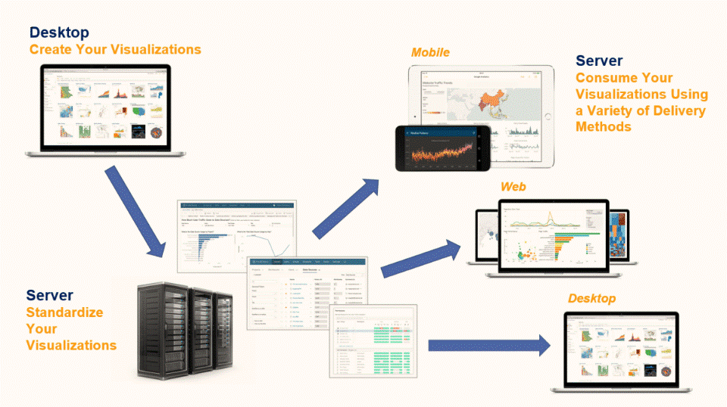
Deployment
Tableau Deployment:
Tableau Server provides a full modern analytics platform for your users. Tableau’s architecture is flexible, allowing you to run the platform just about anywhere. You can install Tableau Server on-premises, in your private cloud or data center, on Amazon EC2, Google Cloud Platform, MS Azure, or Alibaba Cloud. Tableau Server can also run on virtualization platforms.
Publish datasets and reports from Tableau Desktop:
If you want to share your data discoveries with the world outside of your organization, you can save your workbook to Tableau Public, a free cloud service. On Tableau Public, anyone can interact with your views, or download your workbooks or data sources.

